Slide 1

Company Profile
2025

Slide 2

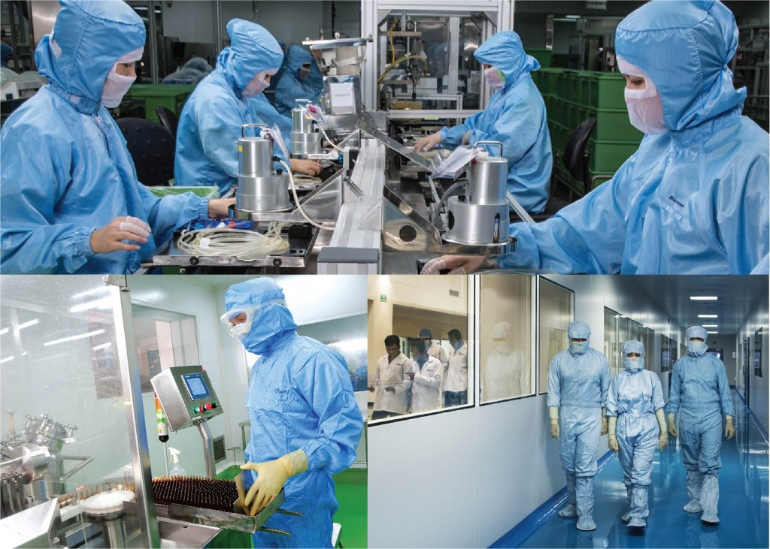
About MERSI
Mersi is a global, integrated specialty pharmaceutical company focused on developing, manufacturing and distributing products; prescription drug (generic and brand), OTC pharmaceutical and nutritional products.
Established in 1997, plant construction in 1999, commencing production in 2000, Mersifarma continuously improves Quality, Safety and Efficacy as well as developing new products for various medication targets.

Slide 3
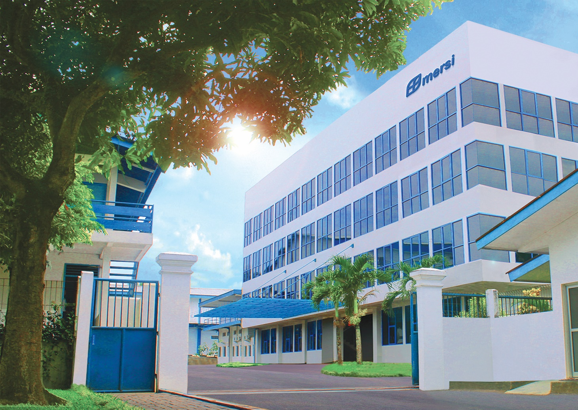
Vision
Mersi as leading pharmaceutical industry in home country and abroad based on universal international standards.
Mission
To provide and distribute quality medicine, evenly and adequately available at affordable price to society at large to improve public health level in Indonesia and International community

Slide 4
Our Motto
“Good Quality Improves Life’s Quality”
with the development of new products with certain quality and excellence, to meet the needs of the society.

Slide 5
Product Class Therapy (212 products)
Anti Psychotic
Vitamin & Mineral
(Pregnant & Nursing)
Anti Nemics
Anti Trombotic
Anti Parkinsonism
Anti Malaria
Anti Mania
CNS Stimulant
Calcium Carbonate, Vitamin D
Anti Ulcerant
Anti Vertigo
Neurotropic Vitamin
Anti Meningitis
Anti Tuberculosis
Minor Tranquilizer
Recovery Stroke & TBI
Anti Depressant
Cerebro Activator
Mucolytic Agent
Analgesic Anti
Pyretic & NSAID
Antidiabetic
Nootropic Agent
Antigout
Anti Alzheimer’s
Anti Anemia
Antibiotic
Cough & Cold Preparations
Anti Convulsant
Anti Hypertension
Anti Hyperlipidemia
Infusion

Slide 6


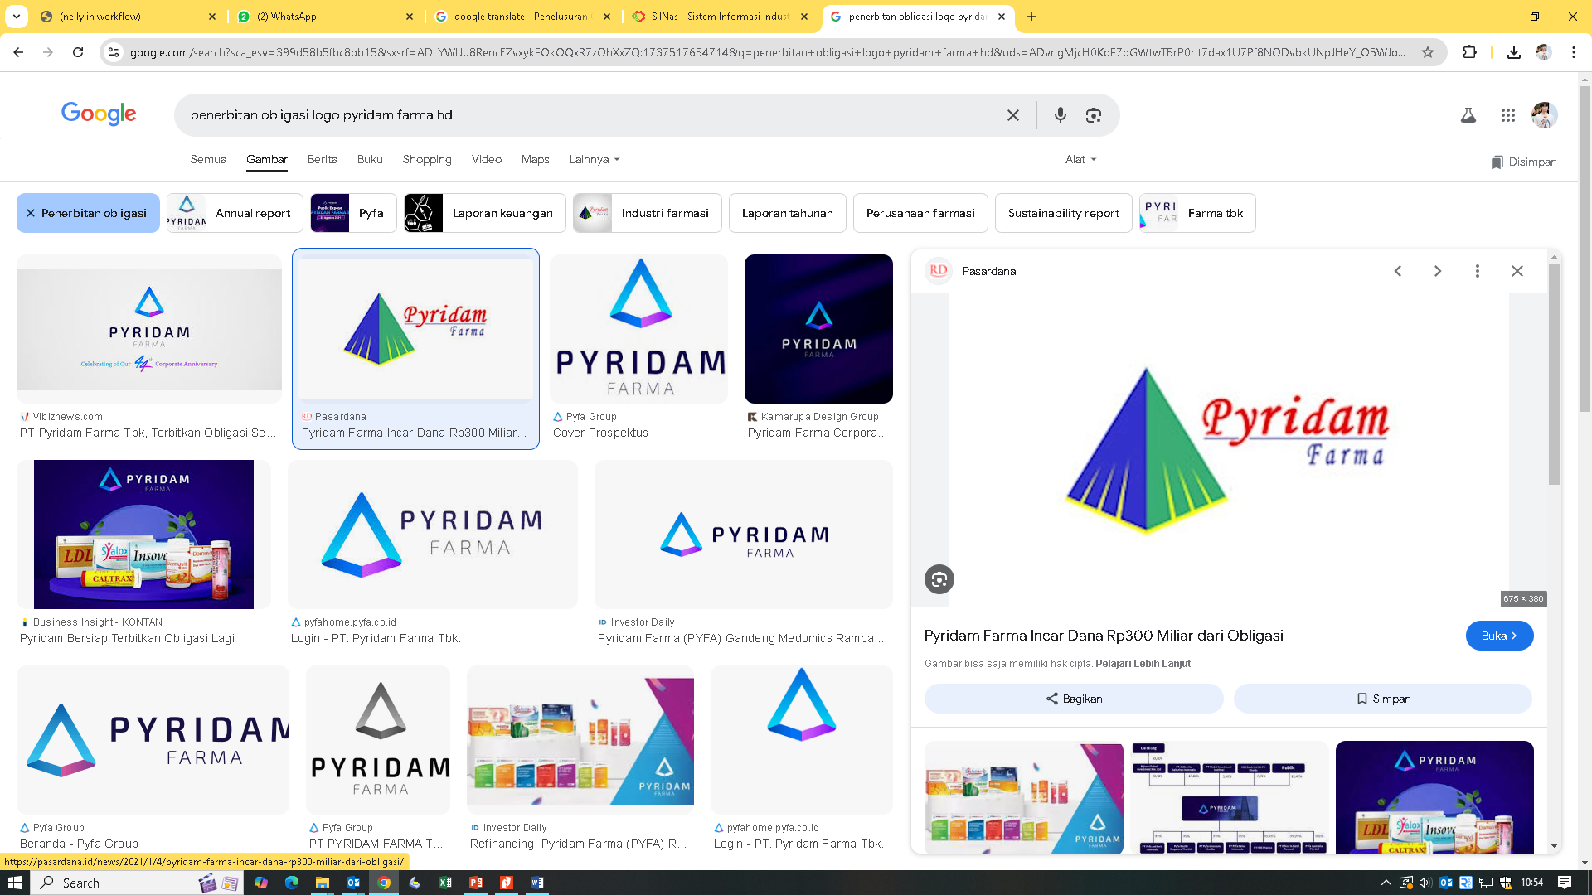


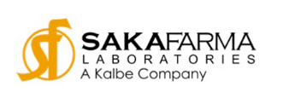


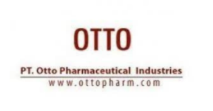
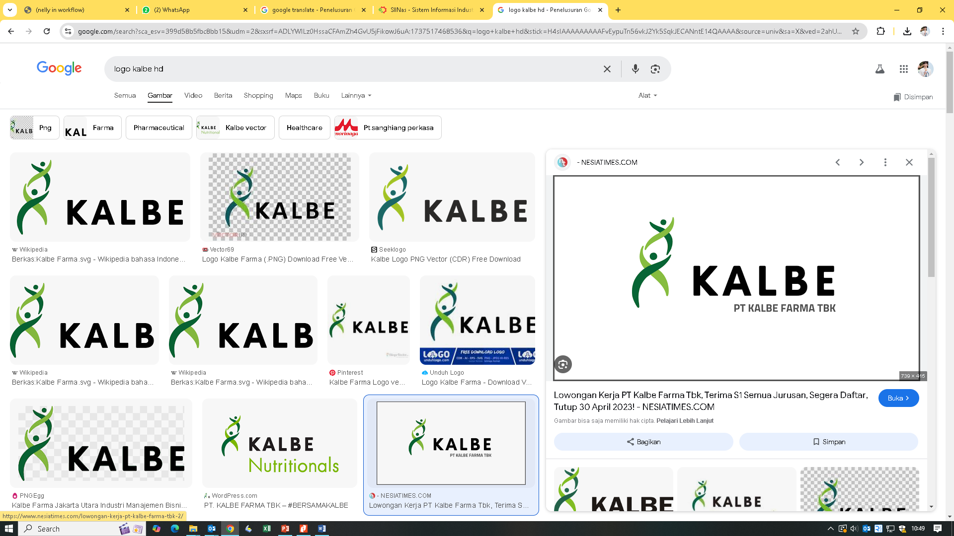


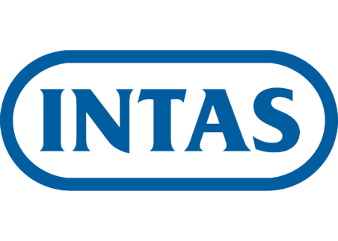


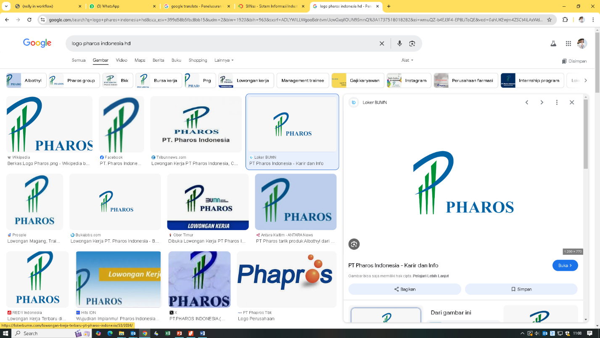
Toll Manufacturing for
Finished Products
Under Licensed
Product
Co
Marketing

Slide 7
Production Buildings
Small & Large Volume Parenteral
( Infusion in Plastic Bottles)
Unit 1
Small Volume Parental
Unit 6
Sterile Unit
Oral Solid & Liquid Dosage Form
1st floor NBL Large Volume Parenteral
2nd floor NBL Small Volume Parenteral
Production NBL
Unit 2
Oral Solid Beta Lactam
Penicillin Dosage Form
Large Volume Parenteral
( Infusion in Plastic Bottles)
Unit 7
Production BLP
Secondary Packaging
1st floor NBL Large Volume Parenteral
2nd floor Vacant Area for Production Expansion
Unit 3
Oral Solid Dosage Form
Production NBL
Large Volume Parenteral
(Infusion in Soft Bags)
Unit 4
Oral Solid Dosage Form
Unit 8
1st floor Production NBL
2nd floor Production NBL (Expansion)
3rd floor Vacant Area for Production Expansion
1st floor NBL Large Volume Parenteral
2nd floor Vacant Area for Production Expansion
Basement Traditional Medicine Production
Unit 5
Topical Liquid & Semi
Solid Dosage Form
1st floor Cold Storage Vaccine
2nd floor Topical Preparation
Central Warehouse
Main buildings
Office & Laboratory
Basement – Packaging Material Storage
1st floor Finished Good Storage
2nd floor Raw Material Storage
1st floor General Office
2nd floor Chemical Laboratory
3rd floor QA, QC, Technical Support
4th floor Microbiology Laboratory

Slide 8
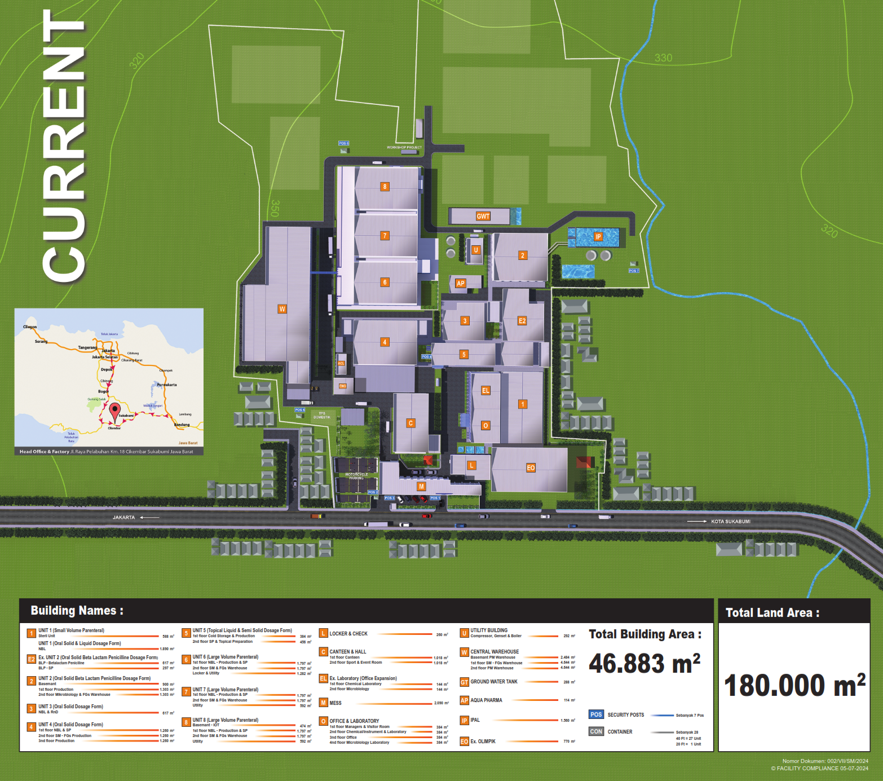

Slide 9
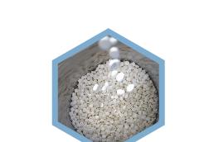
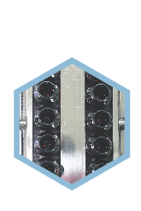
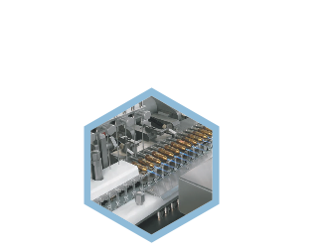
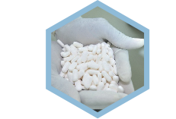
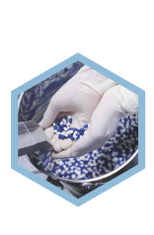

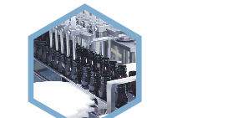
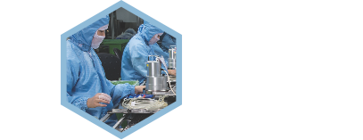
Production Capacity
Tablets (NBL)
Nonsterile Inhalation and Nasal Fluids
Coated, Non-Coated, Caplets
6.183.324.000
1.278.000
Caplets (BLP)
Injection (Ampoules)
388.800.000
Small Volume Parenteral
78.749.496
Capsules
Injection (Vials)
347.760.000
Small Volume Parenteral
9.335.088
Syrup (bottles)
Injection (Infusion)
38.640.000
Large Volume Parenteral
Plastic Bottle
11.520.000
Dry Syrup (BLP)
Soft Bag
11.640.000
43.470.000

Slide 10
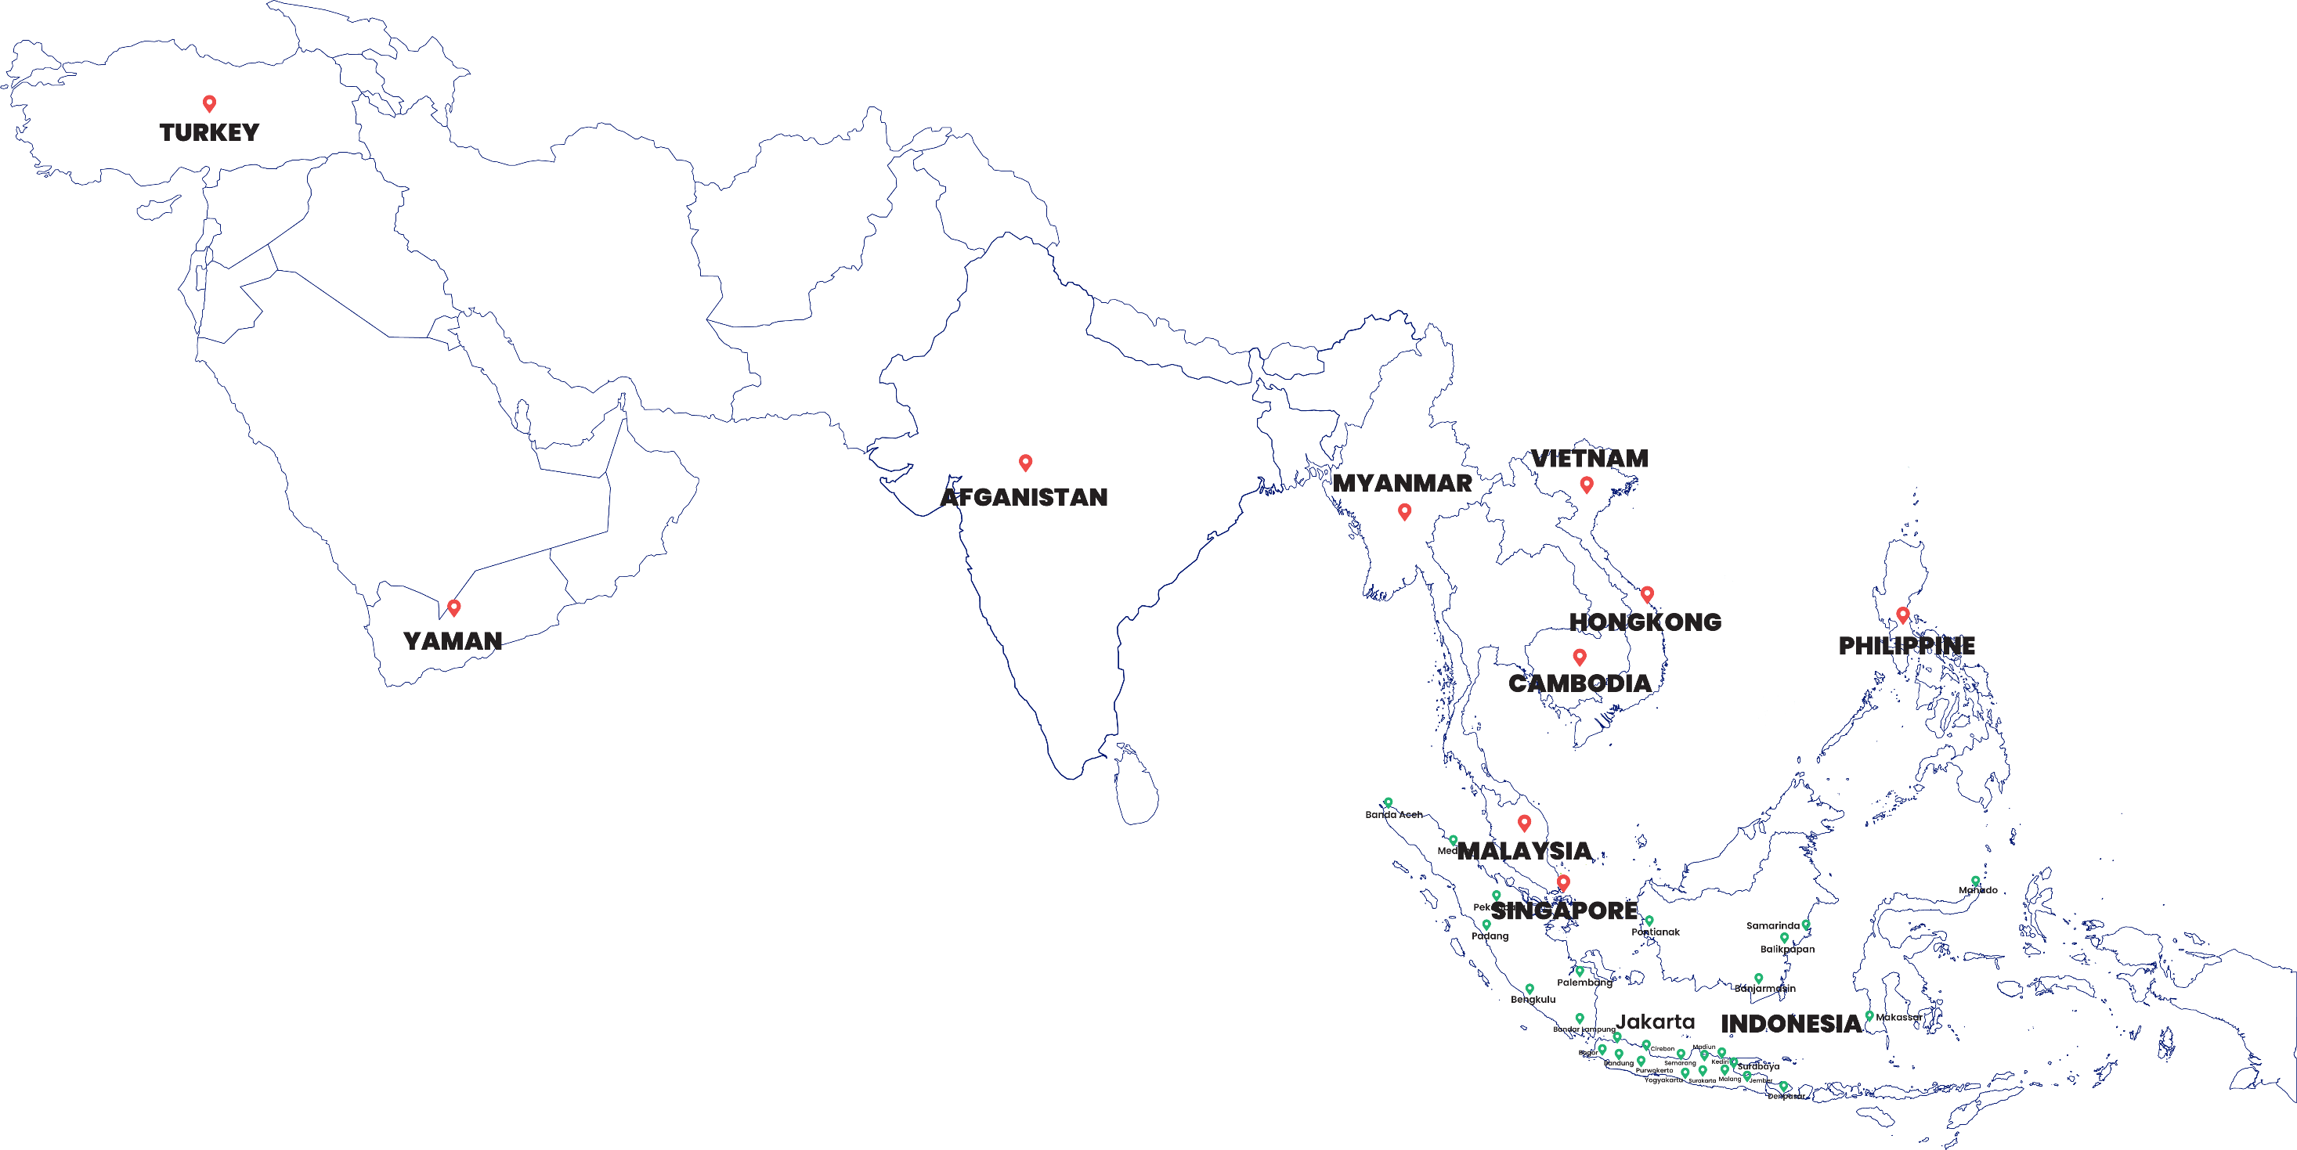


Marketing & Sales Map
Mersi has 25 marketing representative offices that ready to serve customers through Indonesia
Marketing representative offices (25)
Export (10)

Slide 11
List of GMP Certificates
Non-betalactam Tablet
Non-betalactam Oral Liquid
Non-betalactam Hard Capsule
Non-betalactam Semisolid
Nonsterile Inhalation and Nasal Fluids
Tablet and Coated Tablet of Penicillin and Its Derivatives
Penicillin Oral Powder and Its Derivatives
Non-betalactam Large Volume Injection
Non-betalactam Small Volume Injection

Slide 12
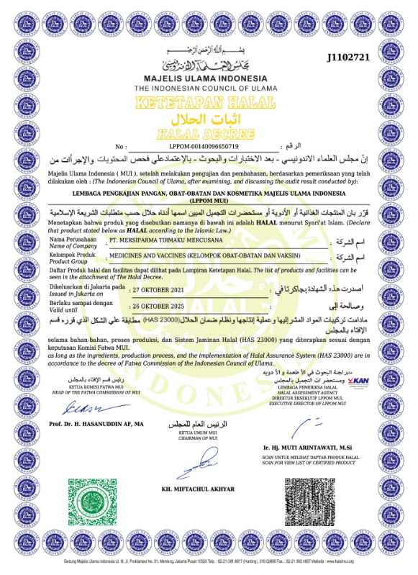
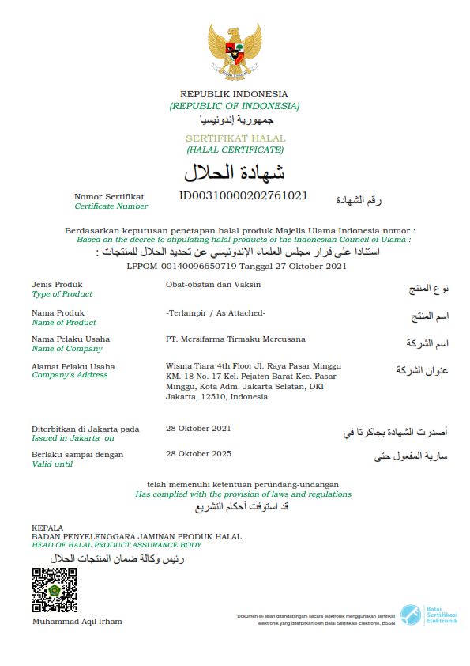
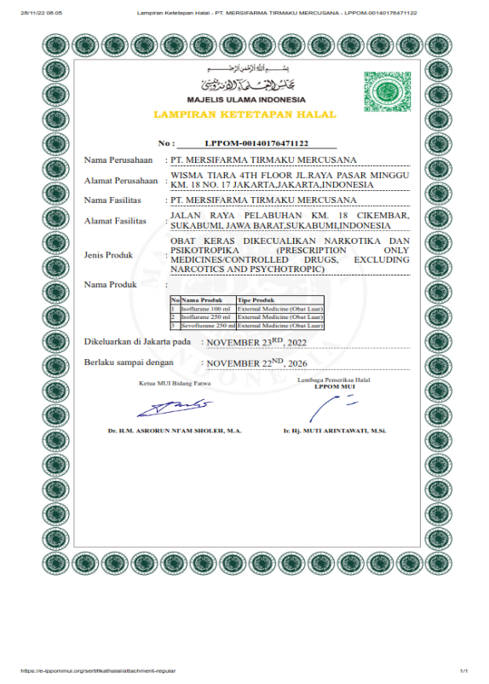
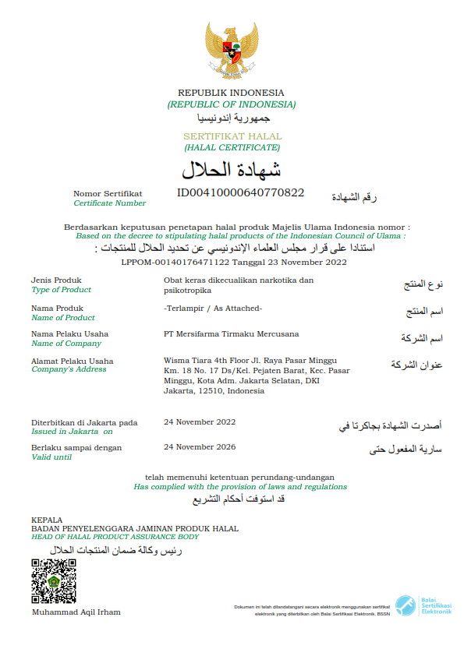
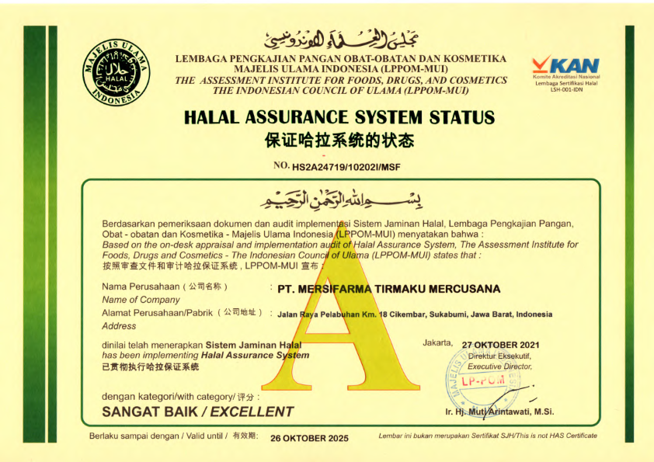
HALAL Certificate PT. Mersifarma TM
HALAL Assurance System PT. Mersifarma TM

Slide 13
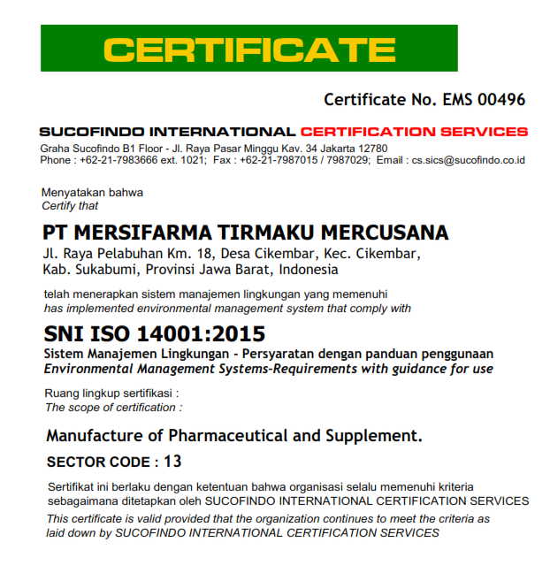
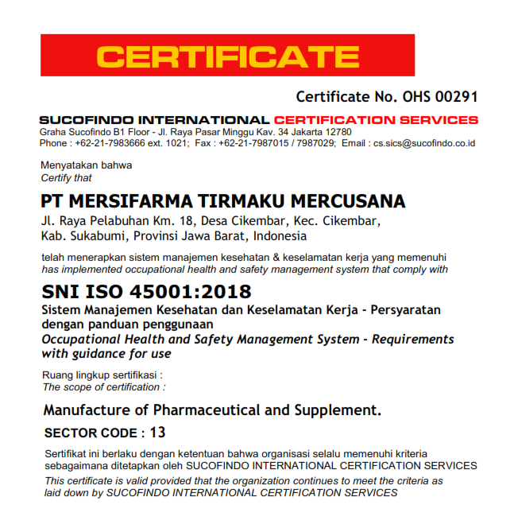
ISO 14001 & ISO 45001

Slide 14

Thank You
Head Office & Factory
Jl. Raya Pelabuhan Km. 18,
Cikembar Sukabumi, Jawa Barat 43157
T : +62 266 321877
F : +62 266 321878
E : mersi.smi@mersifarma.com
www.mersifarma.com
Branch & Marketing Office
Wisma Tiara 4th floor
Jl. Raya Pasar Minggu Km. 18 No. 17, Jakarta 12510
T : +62 21 7987683
F : +62 21 7987686
E : mersi.jkt@mersifarma.com
www.mersifarma.com

