Slide 1

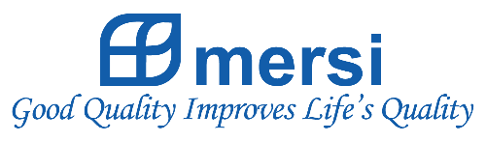
Company Profile
PT MERSIFARMA TIRMAKU MERCUSANA

Slide 2

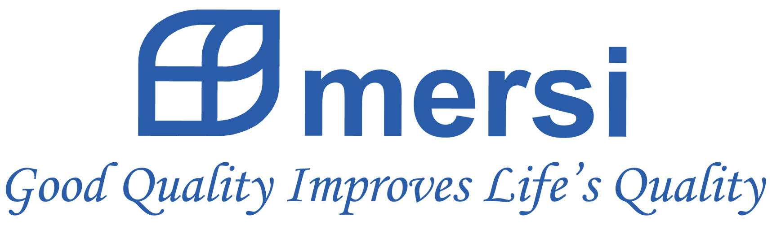

Slide 3
About MERSI
Mersi is a global, integrated specialty pharmaceutical company focused on developing, manufacturing and distributing products; prescription drug (generic and brand), OTC pharmaceutical and nutritional products.
Established in 1997, plant construction in 1999, commencing production in 2000, Mersifarma continuously improves Quality, Safety and Efficacy as well as developing new products for various medication targets.

Slide 4
Our Motto
“Good Quality Improves Life’s Quality”
with the development of new products with certain quality and excellence, to meet the needs of the society.

Slide 5

Vision
Mersi as leading pharmaceutical industry in home country and abroad based on universal international standards.
Mission
To provide and distribute quality medicine, evenly and adequately available at affordable price to society at large to improve public health level in Indonesia and International community

Slide 6
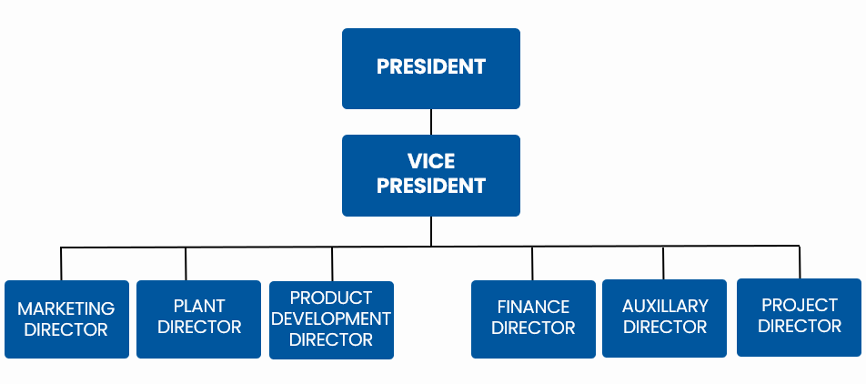
Structure MERSI

Slide 7
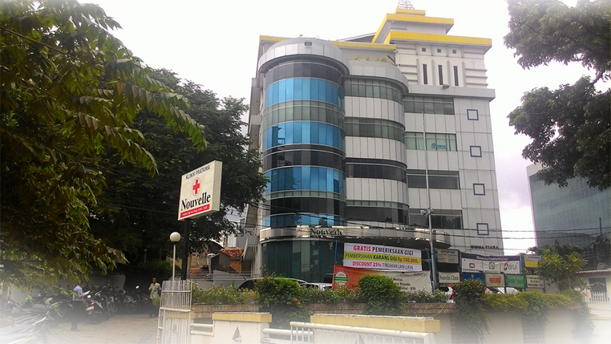
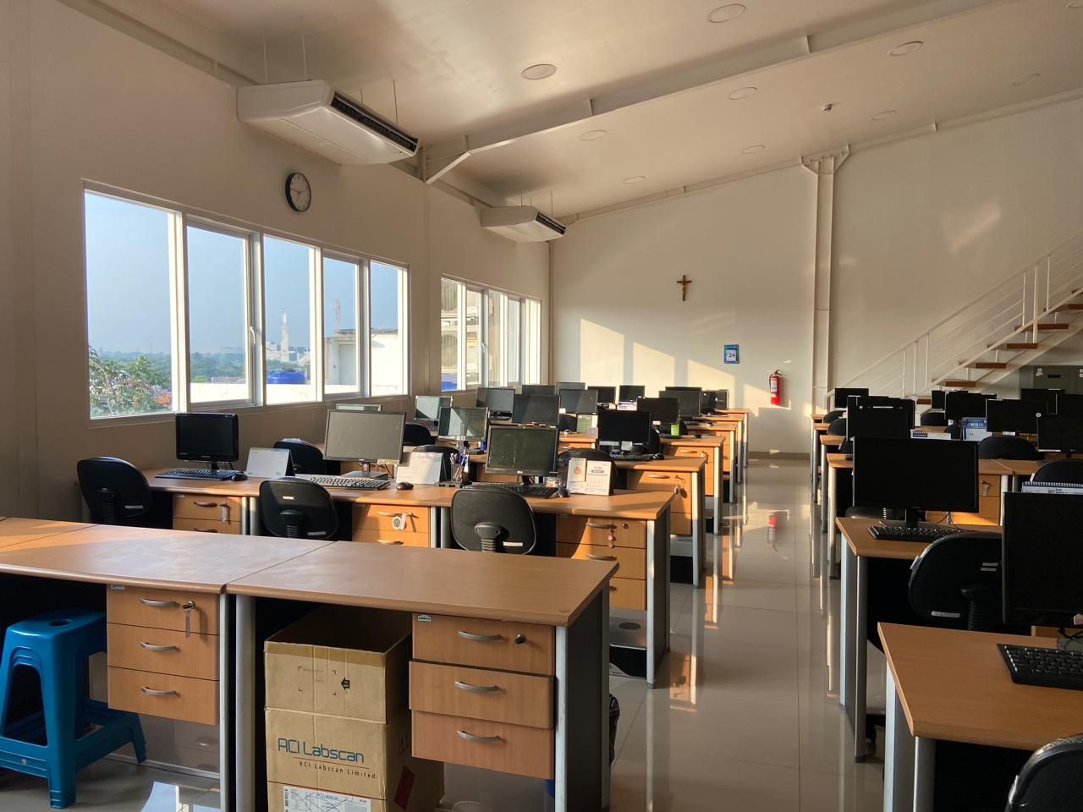
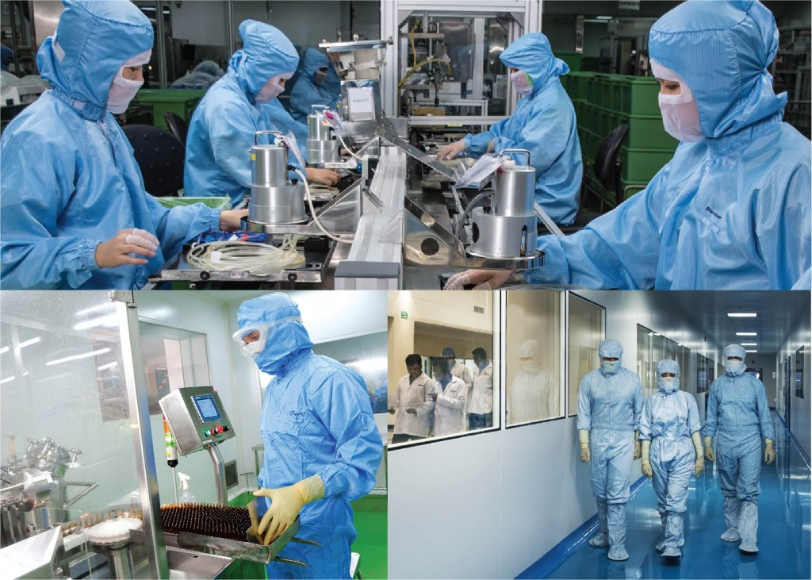
Location MERSI
BRANCH AND MARKETING OFFICE
JAKARTA
RESEARCH AND DEVELOPMENT CENTER
JAKARTA
FACTORY AND HEAD OFFICE
SUKABUMI

Slide 8
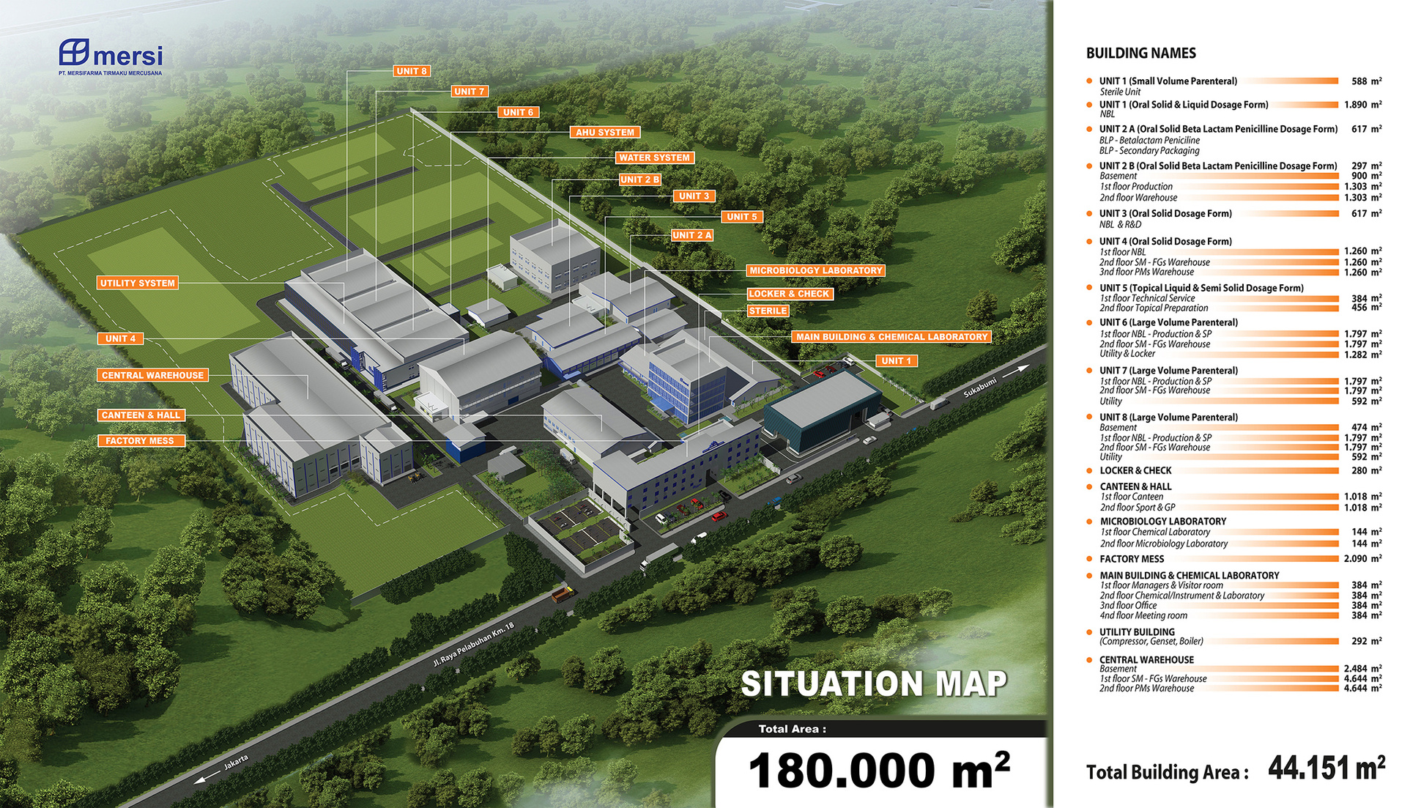
Plant MERSI

Slide 9
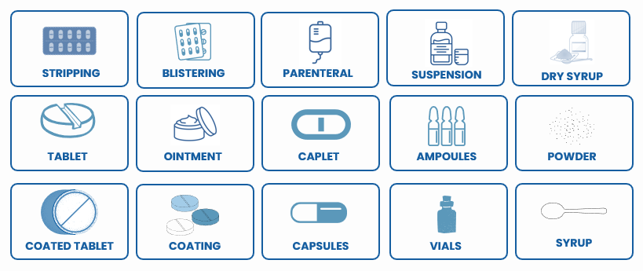
Capabilities MERSI

Slide 10
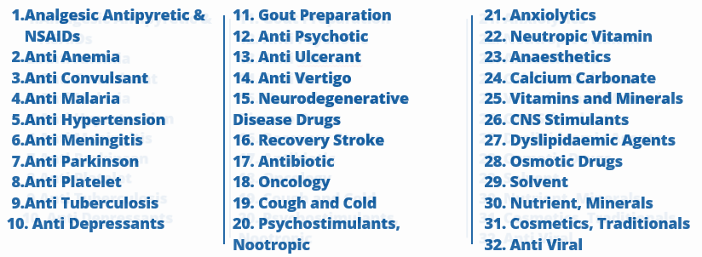
Product Class Therapy (212 products)

Slide 11
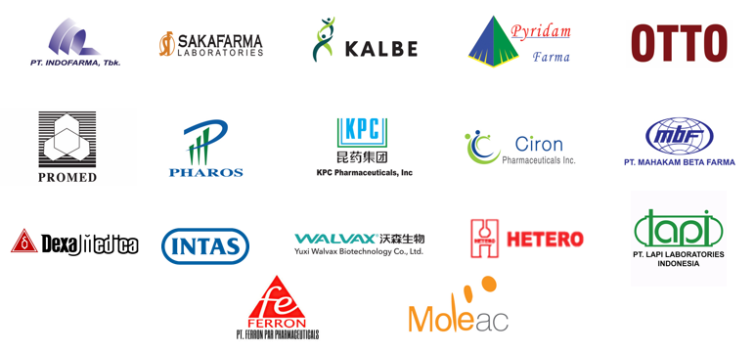
Partnership MERSI

Slide 12


Kantor Pusat dan Pabrik
Jalan Raya Pelabuhan Km. 18
Cikembar Sukabumi - Jawa Barat
Telp. (0266) 321877 - Fax. (0266) 321878
Kantor Marketing dan Cabang
Wisma Tiara Building, 4th Floor
Jalan Raya Pasar Minggu Km 18 No. 17
Jakarta 12510
Telp. (021) 7987683 - Fax. (021) 7987686

